Slide 1

Pizza Sales Analysis
Using SQL
By ARGHADIP CHARAN

Slide 2
OBJECTIVE
The objective of the Pizza Sales Analysis project using MySQL is to systematically examine and interpret the sales data of a pizza business to gain valuable insights that can drive strategic decision-making. By leveraging MySQL for this comprehensive sales analysis, the pizza business aims to enhance profitability, improve customer satisfaction, and make informed strategic decisions to drive sustainable growth.

Slide 3
Business Questions
Sales Analysis
What is the total number of order placed ?
What is the total Revenue generated from pizza sales ?
What are the revenue contribution with percentage of each pizza type and size and their quantity sold ?
Product Performance
Identify Top 3 Highest-priced pizzas.
Identify best selling pizzas.
What is the Avg. price of Pizzas ?
Customer Behavior
What is the peak hours for Pizza Order ?
What is the average number of Pizza ordered per day ?
Pricing Strategy
Check out the prices of Pizzas & their Sales volume.

Slide 4
Sales Analysis

Slide 5


Total number of order placed

Slide 6


Total Revenue generated from pizza sales

Slide 7
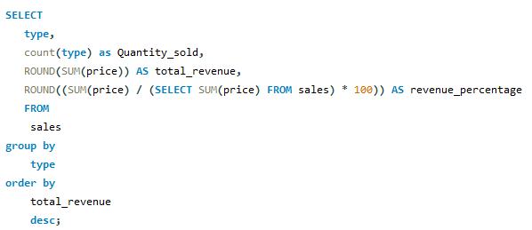
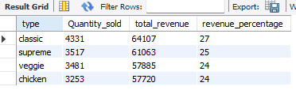
Revenue contribution & quantity sold of each pizza types

Slide 8
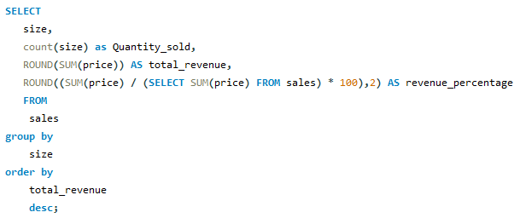
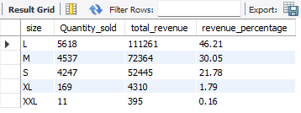
Revenue contribution & quantity sold of each pizza size

Slide 9
Product Performance

Slide 10
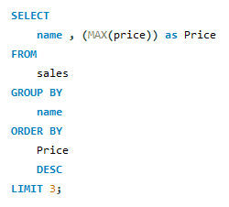
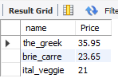
Identify Top 3 Highest-priced pizza

Slide 11
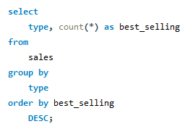
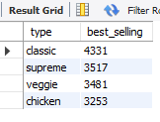
Best selling pizzas by type

Slide 12


Identify the Avg. price of Pizzas

Slide 13
Customer Behavior

Slide 14
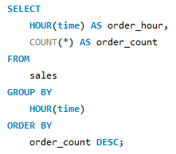
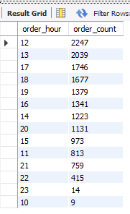
Peak hours for Pizza Order

Slide 15
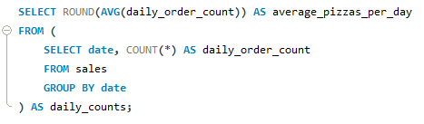

Avg. Pizza ordered per day

Slide 16
Pricing Strategy

Slide 17
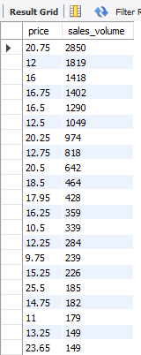
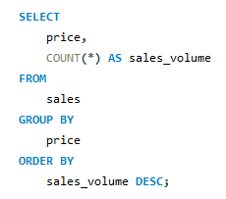

Price of Pizza & their Sales volume

Slide 18
Findings
This Analysis identify the Total Revenue from all type pizza is $260331 out of which
Large size ($119840) & Classic type ($69297) are the highest.
Total number of order is 15766 out of which Classic type is the highest ordered pizza.
Highest priced pizza is “The Greek” ($35.95) and the average price of all pizza is $17.
$ 20.75 priced pizza has highest Sales Volume.
Peak time of most order is 12 p.m. – 1 p.m. & 5 p.m. – 7 p.m.
Average pizza ordered per day is 138.

Slide 19
Thank You

